Slide 1
INNOVATIVE IOT SOLUTION FOR CONTACTLESS ATTENDANCE WITH TEMPERATURE DETECTION
SUPERVISIOR
Dr. R. Karthick
Associate Professor
Dept Of CSE
SUBMITTED BY
Adithya S S - 910619104004
Harshan R S - 910619104027
Jeya Prathap P - 910619104035
Notes:
1

Slide 2
ABSTRACT
To create an attendance system that can be used in a variety of institutes and is dependable, effective, and secure.
To identify the person, the system matches the captured face with the stored database.
To record attendance, which cuts down on the time and work needed for human attendance.
To handle the pandemic situation by detecting body temperature of people entering the building and preventing viral spread.

Slide 3
INTRODUCTION
To recognize a face based on to give a attendance.
A camera is used to capture the near frontal view of the person face then it will be check.
To analyze the person then it will record a attendance and results will be announced by voiceover.
It could be trending technology almost utilized in every area from security, research, automation and lot of more things.
To monitor a body temperature and it will be displayed.

Slide 4
EXISTING SYSTEM
Based on Face Recognition Attendance Management System which integrates images of person’s face authentication into the process of attendance management.
Attendance management is the act of managing attendance or presence in a work setting to minimize loss due to employee downtime.
Fingerprint based attendance system which uses fingerprint sensor to record timing of person entry and exit by their dataset names.

Slide 5
PROPOSED SYSTEM
To realize an attendance system that can be managed through face recognition using CNN deep neural network algorithm.
Two-stage networks to reach the goal of face detection and recognition by means liveness of people.
The recognition results will be announced by voiceover.
To record the temperature of people using temperature sensor while assisting them to punch in and out.
Accuracy has been increased for detection of human faces and temperature.

Slide 6
REQUIREMENTS
Hardware Specifications
Webcam
Arduino Uno
MLX90614 Temperature Sensor
Laptop
Breadboard
Jumper Pins
Software Specifications
Python 3.7
Pycharm
Arduino IDE

Slide 7
LITERATURE SURVEY
S. No | Title of the paper | Author & Publication | Methodology | Merits/Demerits
1 | DVG-Face: Dual Variational Generation for Heterogeneous Face Recognition | Chaoyou Fu , Xiang Wu , Yibo Hu, Huaibo Huang , and Ran He , Senior Member, IEEE 2022 | To integrate abundant identity information of large-scale visible data into the joint distribution..As a consequence, massive new diverse paired heterogeneous images with the same identity can be generated from noises. The identity consistency and identity diversity properties allow us to employ these generated images to train the HFR network via a contrastive learning mechanism, yielding both domain-invariant and discriminative embedding features. | Achieves superior performances over state-of-the-art methods on seven challenging databases belonging to five HFR tasks, including NIR-VIS, Sketch-Photo, Profile-Frontal Photo, Thermal-VIS, and ID-Camera
Notes:
7

Slide 8
2 | Smart Attendance System using Machine Learning | Prof. Shweta S Bagali1 , Dr K Amuthabala , Prof. Iranna Amargol , Mr H Prajwal,2021 | The main goal of this research is to look into a calculation that can be used in biometric participation frameworks using reasonable methodologies and readily available data. The calculation primarily makes use of histogram-arranged slopes for watching faces, assessing face milestones, a support vector machine to perceive the face, and deep convolutional networks to think about faces. | This product project makes use of various important Dot Net APIs to collaborate and obtain the results of a nearby camera.
3 | WebFace260M: A Benchmark for Million-Scale Deep Face Recognition | Zheng Zhu , Member, IEEE, Guan Huang, Jiankang Deng , Student Member, IEEE, Yun Ye, Junjie Huang , Member, IEEE, Xinze Chen, Jiagang Zhu, Tian Yang , Dalong Du, Jiwen Lu , Senior Member, IEEE, and Jie Zhou , Senior Member, IEEE,2021 | The cleaned WebFace42M is the largest public face recognition training set and we expect to close the data gap between academia and industry. Referring to practical deployments, Face Recognition Under Inference Time constraint (FRUITS) protocol and a new test set with rich attributes are constructed. | Enormous potential on standard, masked and unbiased face recognition scenarios.

Slide 9
BLOCK DIAGRAM
Start
Face
Detected
(Liveliness)
Yes
No
Live video
Capturing
Save attendance in database
Continue video capturing
CNN results
Detect Temperature
End

Slide 10
MODULES
Image Processing
Facial Recognition
Temperature Detection
Liveliness detection
Real Time Tracking

Slide 11
IMAGE PROCESSING
The alteration of digital photographs using mathematical methods and computer technology is referred to as image processing.
Image processing aims to improve, edit, or analyze digital pictures in order to extract usable information from them.
Detection can be done by the location of faces in the image using techniques such as Haar cascades, HOG + SVM, or deep learning-based methods like CNNs

Slide 12
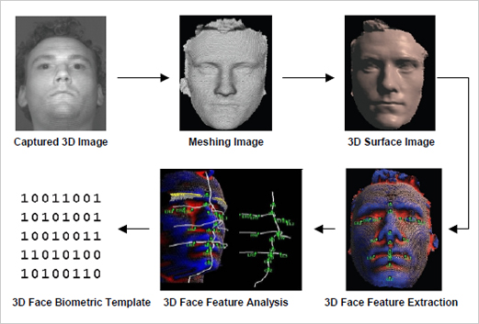
SCREENSHOT

Slide 13
FACIAL RECOGNITION
Face recognition is a computer vision technology that involves identifying individuals from digital images or videos.
The face recognition library in Python utilizes convolutional neural networks (CNNs) to extract facial features from images and videos.
The face recognition library in Python supports different types of face recognition algorithms, including the Eigenfaces algorithm, Fisherfaces algorithm, and Local Binary Patterns Histograms (LBPH) algorithm is used in attendance system.

Slide 14
FACE RECOGNITION USING CNN ALGORITHM
The faces of individuals can be detected, aligned, and recognized, it will process the face images by data augmentation, transfer learning, and ensembling.
CNN algorithm is a kind of network architecture for deep learning algorithms specially used for image recognition.
CNN algorithm uses pre trained models like VGGFace, FaceNet, and DeepFace for improving performance and accuracy by super tuned fit model to detect the new faces at the Real time manner.

Slide 15
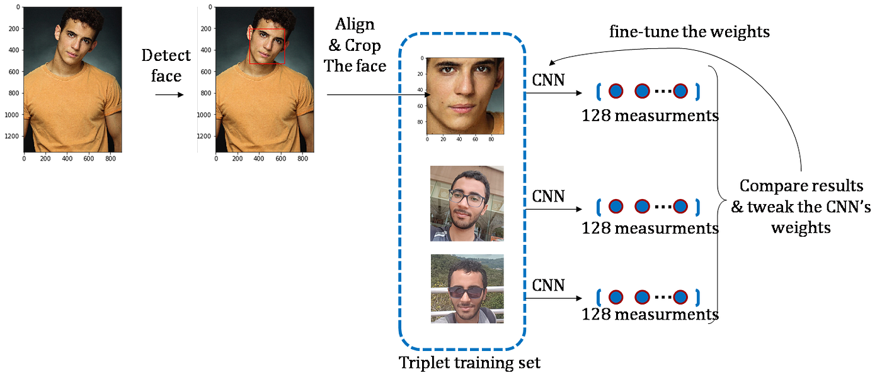
SCREENSHOT

Slide 16
DATA FLOW DIAGRAM
Start
Acquire live video from camera
Convert color to gray-scale
Detect faces
Face
Detected
Yes
No
Liveliness Detection
Continue video capture until face is detected

Slide 17
TEMPERATURE DETECTION
The MLX90614 is a contactless infrared temperature sensor that measures temperature without contacting the person being measured.
The sensor measures an object's thermal radiation and uses that measurement to determine the temperature of the object.
The MLX90614 sensor has a wide temperature measuring range, typically between -40°C and 125°C, and can be used to measure both human and object temperatures.
The Sensor can be used with a microcontroller or other processing unit to analyze temperature data and determine whether it falls within a predetermined range and used to find fever illness.

Slide 18
DATA FLOW DIAGRAM
Initialize the MLX90614 sensor
Detect Temperature
If temperature exceeds limit
Yes
No
Store the information and isolate the person
Store the information
End

Slide 19
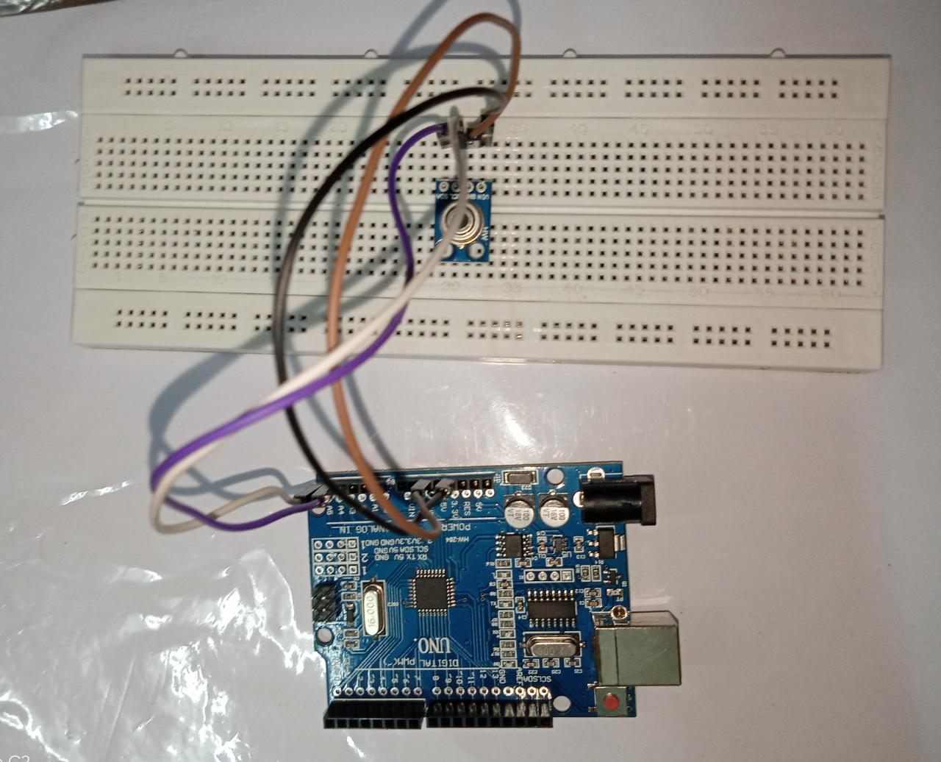
SCREENSHOT

Slide 20
LIVELINESS DETECTION
To detect facial landmarks and movements, as well as to compare and match faces to detect potential spoofing attacks.
To use a Convolutional Neural Networks (CNN) and Local Binary Pattern (LBP) pattern descriptor algorithms.
The system will analyze the biometric input and determine whether it is genuine or fraudulent and prevent attendance fraud and ensure the integrity of the attendance data.

Slide 21
REALTIME TRACKING
Real-time tracking of facial recognition systems involves continuously analyzing live video feeds and identifying individuals by comparing their facial features to a database of known faces.
Tracking in face recognition involves the use of complex algorithms that analyze and compare facial features to detect and track individuals.
The use of realtime tracking in face recognition systems has revolutionized security and surveillance applications, making it easier to monitor and track individuals in real-time.

Slide 22
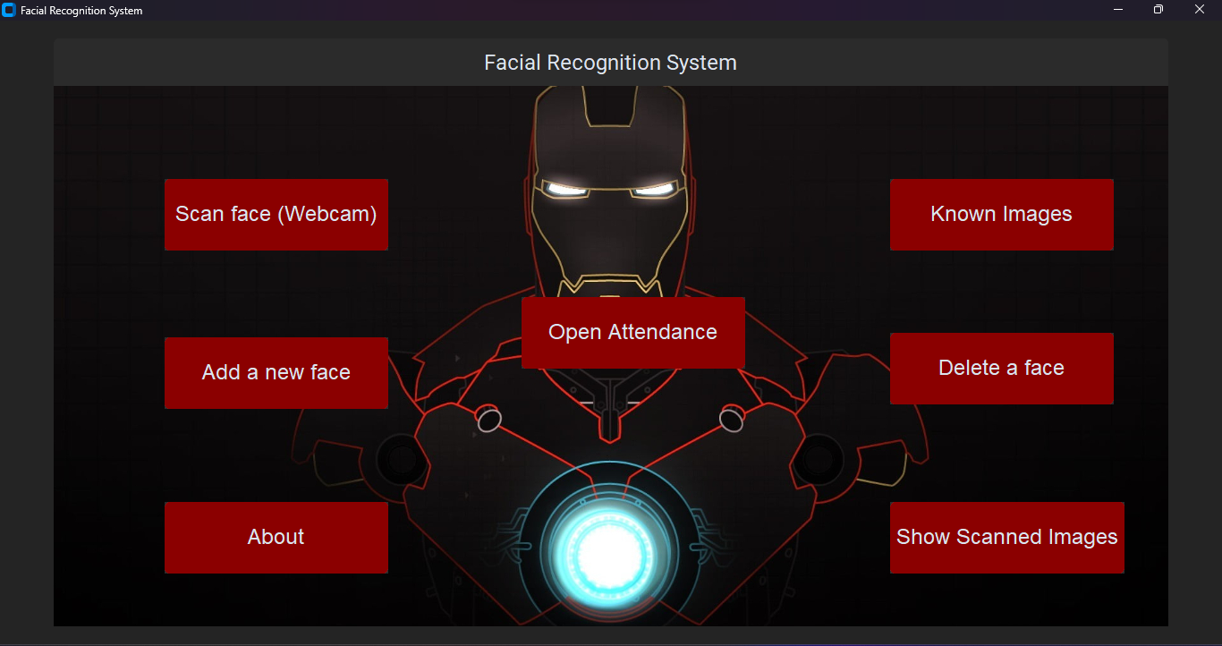
SCREENSHOT

Slide 23
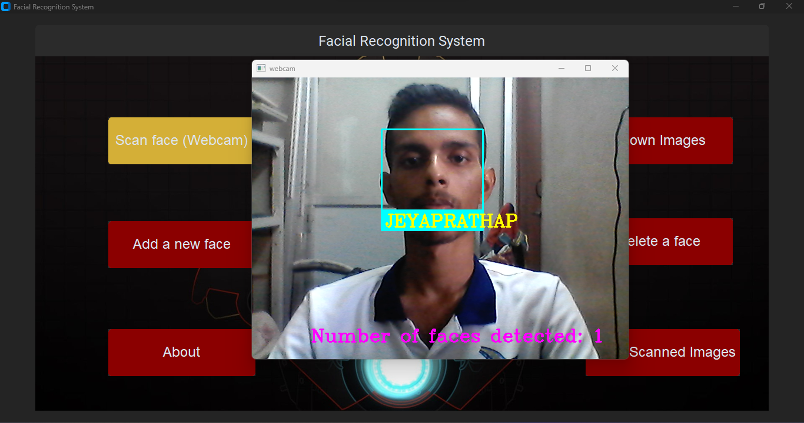
SCREENSHOT

Slide 24

SCREENSHOT

Slide 25

SCREENSHOT

Slide 26
CONCLUSION
The System has been envisioned for the purpose of reducing the errors that occur in the traditional (manual) attendance taking system.
This is particularly useful for detecting fevers and therefore possible infections of COVID-19 and other illnesses.
These system can be used in the entrance of any organization and only the people with normal body temperature can entry the rooms.

Slide 27
FUTURE ENHANCEMENT
The system will use advanced temperature sensors to detect changes in body temperature, and if the temperature is found to be above a certain threshold, the system will alert the user and provide them with information on recommended next steps.
In cases where the temperature is excessively high, the system will automatically contact a healthcare center to ensure that the individual receives prompt medical attention.
Accuracy and Performance of the predictive model can be increased.

Slide 28
REFERENCES
[1] J. Deng, J. Guo, N. Xue, and S. Zafeiriou, “Arcface: Additive angular margin loss for deep face recognition,” in IEEE Conference on Computer Vision and Pattern Recognition, 2019.
[2] C. Peng, N. Wang, J. Li, and X. Gao, “Dlface: Deep local descriptor for cross-modality face recognition”, Pattern Recognition, vol. 90, pp. 161–171, 2019.
[3] R. He, X. Wu, Z. Sun, and T. Tan, “Wasserstein cnn: Learning invariant features for nir-vis face recognition,” IEEE Transactions on Pattern Analysis and Machine Intelligence, vol. 41, no. 7, pp. 1761– 1773, 2018.

Slide 29
REFERENCES
[4] L. Song, M. Zhang, X. Wu, and R. He, “Adversarial discriminative heterogeneous face recognition,” in AAAI Conference on Artificial Intelligence, 2018.
[5] H. Zhang, B. S. Riggan, S. Hu, N. J. Short, and V. M. Patel, “Synthesis of high-quality visible faces from polarimetric thermal faces using generative adversarial networks,” International Journal of Computer Vision, vol. 127, no. 6-7, pp. 845–862, 2019..

Slide 30
THANK YOU

